Slide 1
Systems of Equations

Slide 2
A linear system of equations can have zero, one, or an infinite number of solutions. Think of two lines. Those lines might be parallel and not intersect (no solutions), or they might not be parallel and intersect at one point (one solution), or they might be parallel and consistent (an infinite number of solutions).
An inconsistent system is a system of equation that has zero solutions.
A consistent system is a system of equations that has one solution or an infinite number of solutions.

Slide 3
Two systems of equations are defined as equivalent if every solution to one system is also a solution to the second system of equations, and vice versa

Slide 4
Elementary Row Operations
Multiply an equation by a nonzero constant.
Interchange any pair of equations.
Add a non-zero multiple of one equation to a second equation to replace the second equation.

Slide 5
Matrices
A matrix (plural matrices) is a very powerful tool in mathematics. For now, we will introduce matrices as a way to organize our solutions, keeping them neat and organized. Also, matrices will help us to see how we can use elementary row operations to solve a system of equations.
Matrices have many more uses than this, and there are entire university math courses dedicated to them.

Slide 6

Example
Solve the following system of equations using a matrix and elementary row operations.
$2x+y=−9$ ①
$x+2y=−6$ ②

Slide 7

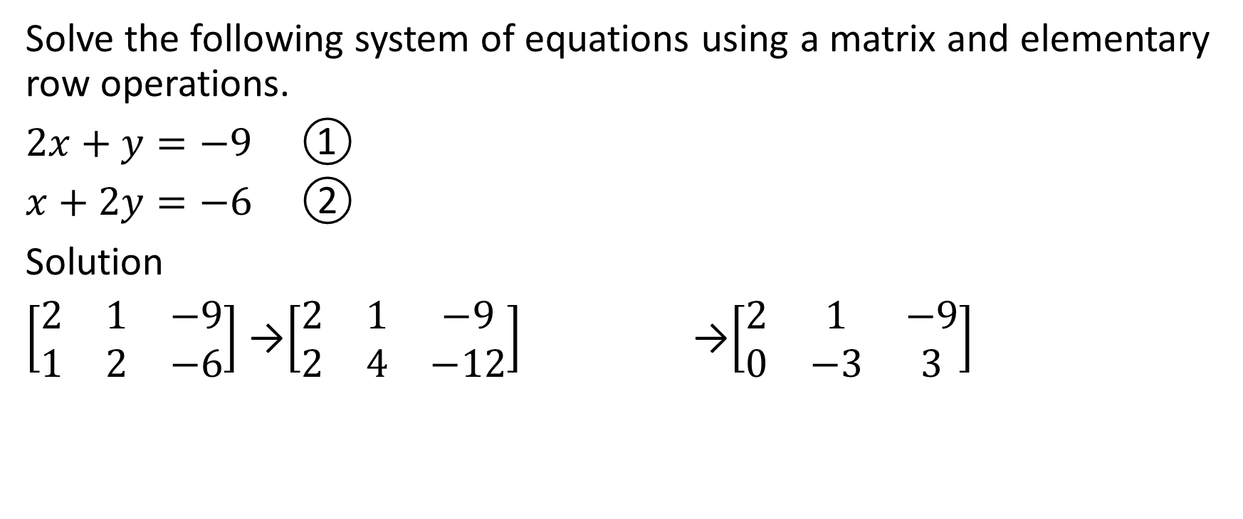


Solve the following system of equations using a matrix and elementary row operations.
$2x+y=−9$ ①
$x+2y=−6$ ②
Solution
$\left[\begin{matrix}2 & 1 & −9 \\ 1 & 2 & −6\end{matrix}\right]$ →$\left[\begin{matrix}2 & 1 & −9 \\ 2 & 4 & −12\end{matrix}\right]$ →$\left[\begin{matrix}2 & 1 & −9 \\ 0 & −3 & 3\end{matrix}\right]$

Slide 8
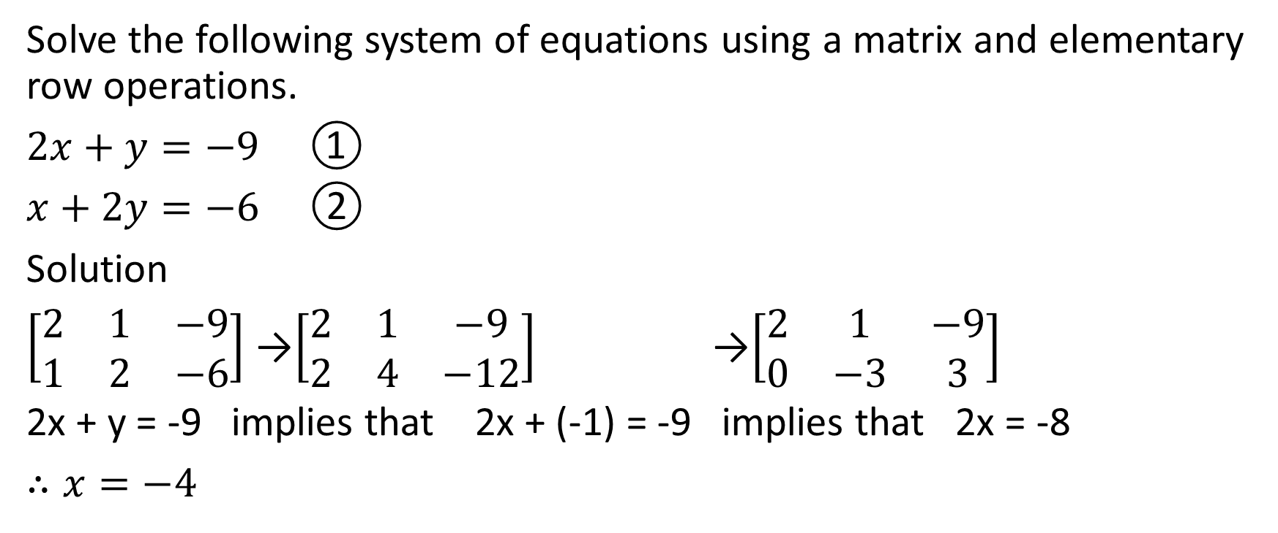
Solve the following system of equations using a matrix and elementary row operations.
$2x+y=−9$ ①
$x+2y=−6$ ②
Solution
$\left[\begin{matrix}2 & 1 & −9 \\ 1 & 2 & −6\end{matrix}\right]$ →$\left[\begin{matrix}2 & 1 & −9 \\ 2 & 4 & −12\end{matrix}\right]$ →$\left[\begin{matrix}2 & 1 & −9 \\ 0 & −3 & 3\end{matrix}\right]$
2x + y = -9 implies that 2x + (-1) = -9 implies that 2x = -8
$∴x=−4$

Slide 9
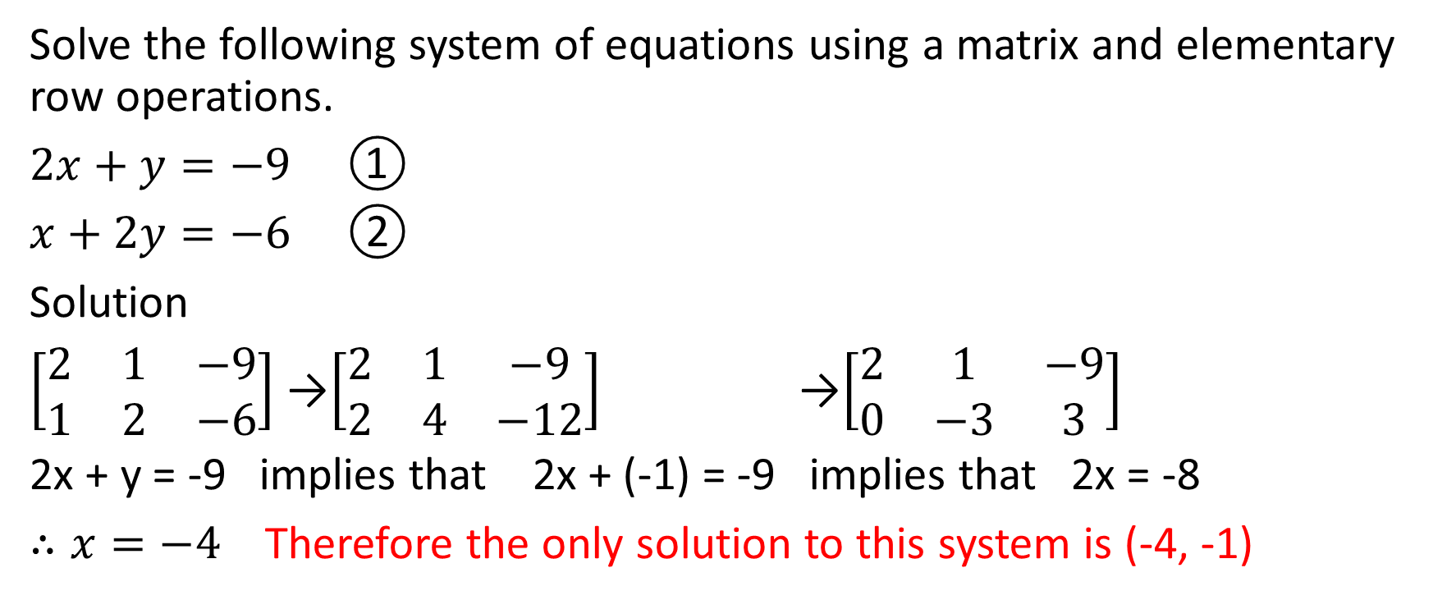
Solve the following system of equations using a matrix and elementary row operations.
$2x+y=−9$ ①
$x+2y=−6$ ②
Solution
$\left[\begin{matrix}2 & 1 & −9 \\ 1 & 2 & −6\end{matrix}\right]$ →$\left[\begin{matrix}2 & 1 & −9 \\ 2 & 4 & −12\end{matrix}\right]$ →$\left[\begin{matrix}2 & 1 & −9 \\ 0 & −3 & 3\end{matrix}\right]$
2x + y = -9 implies that 2x + (-1) = -9 implies that 2x = -8
$∴x=−4$ Therefore the only solution to this system is (-4, -1)

Slide 10

Example
Solve the following system of equations using a matrix and elementary row operations.
$3x+4y=8$ ①
$6x+8y=15$ ②

Slide 11


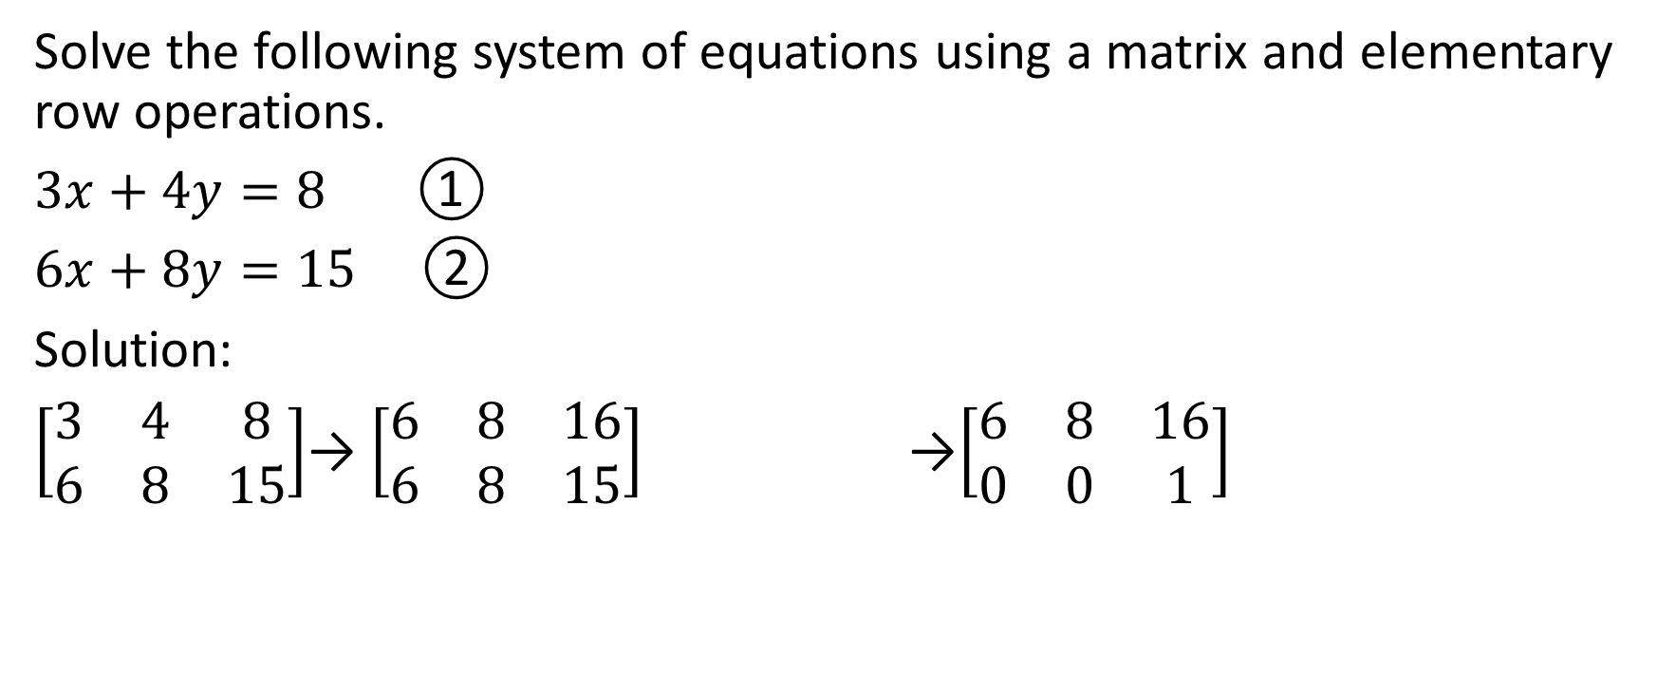


Solve the following system of equations using a matrix and elementary row operations.
$3x+4y=8$ ①
$6x+8y=15$ ②
Solution:
$\left[\begin{matrix}3 & 4 & 8 \\ 6 & 8 & 15\end{matrix}\right]$→ $\left[\begin{matrix}6 & 8 & 16 \\ 6 & 8 & 15\end{matrix}\right]$ →$\left[\begin{matrix}6 & 8 & 16 \\ 0 & 0 & 1\end{matrix}\right]$

Slide 12
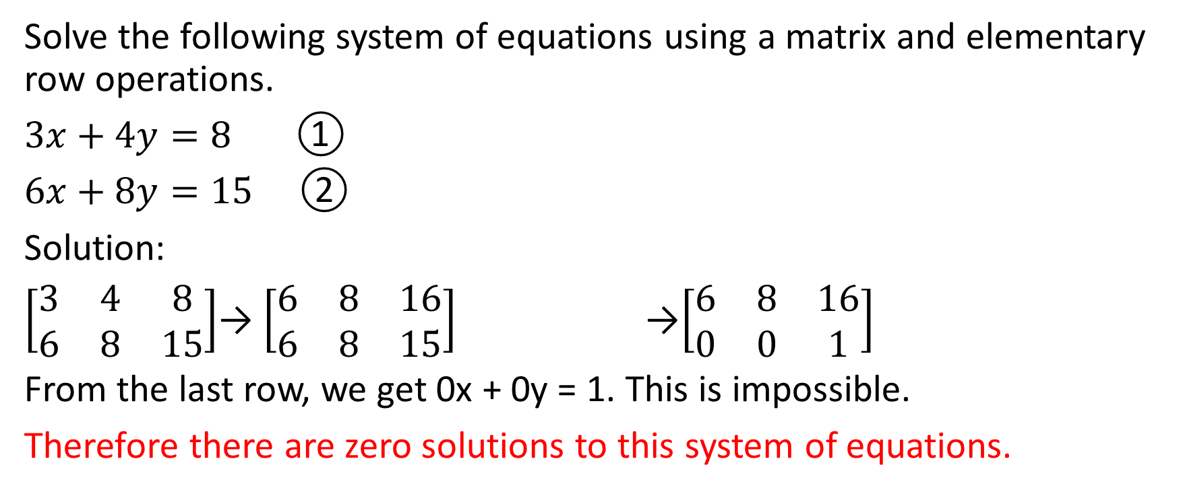

Solve the following system of equations using a matrix and elementary row operations.
$3x+4y=8$ ①
$6x+8y=15$ ②
Solution:
$\left[\begin{matrix}3 & 4 & 8 \\ 6 & 8 & 15\end{matrix}\right]$→ $\left[\begin{matrix}6 & 8 & 16 \\ 6 & 8 & 15\end{matrix}\right]$ →$\left[\begin{matrix}6 & 8 & 16 \\ 0 & 0 & 1\end{matrix}\right]$
From the last row, we get 0x + 0y = 1. This is impossible.
Therefore there are zero solutions to this system of equations.

Slide 13

Example
Solve the following system of equations using a matrix and elementary row operations.
$5x−2y=11$ ①
$55x−22y=1$21 ②

Slide 14
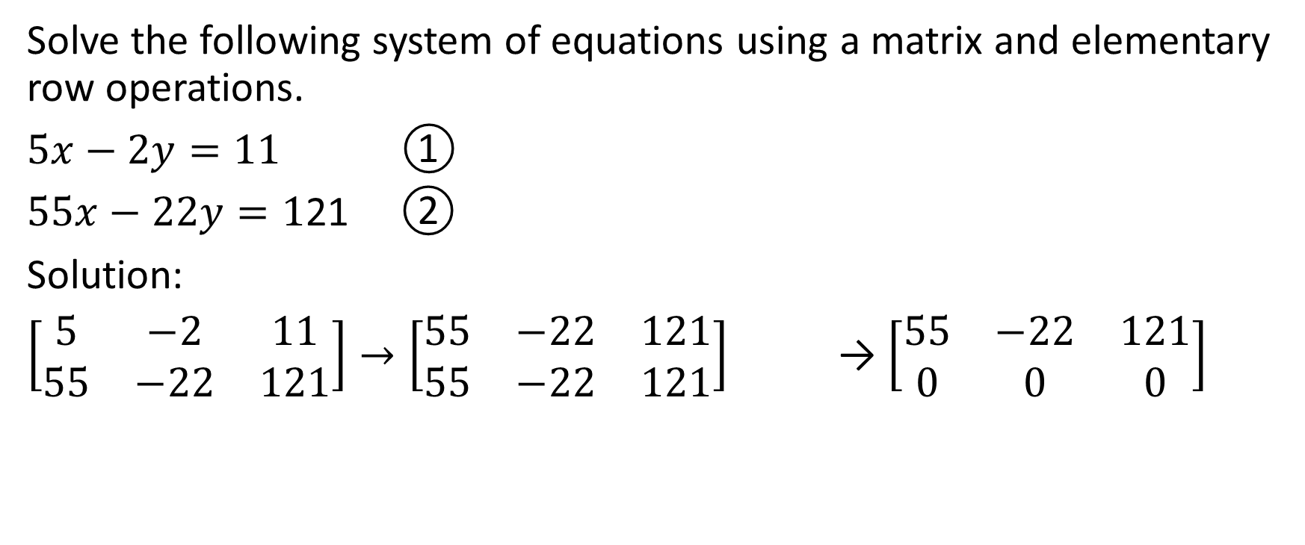


Solve the following system of equations using a matrix and elementary row operations.
$5x−2y=11$ ①
$55x−22y=1$21 ②
Solution:
$\left[\begin{matrix}5 & −2 & 11 \\ 55 & −22 & 121\end{matrix}\right]→\left[\begin{matrix}55 & −22 & 121 \\ 55 & −22 & 121\end{matrix}\right]$ → $\left[\begin{matrix}55 & −22 & 121 \\ 0 & 0 & 0\end{matrix}\right]$

Slide 15
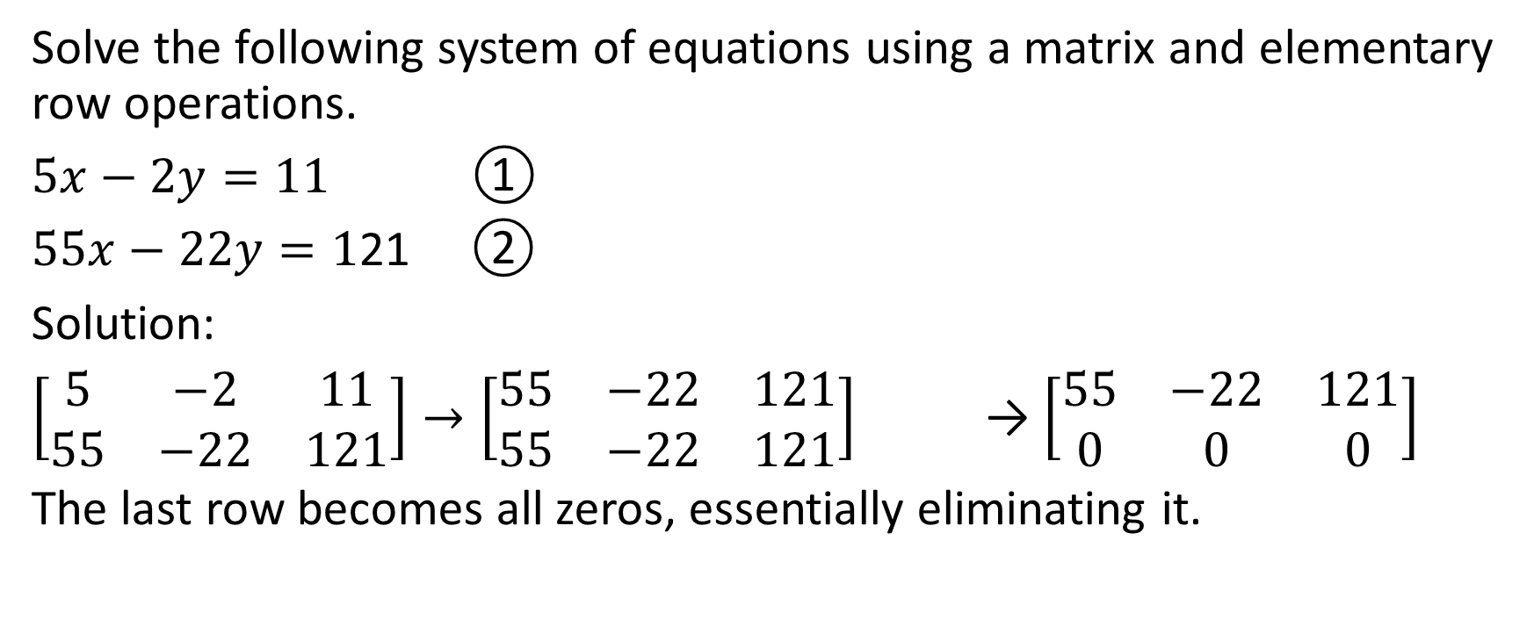
Solve the following system of equations using a matrix and elementary row operations.
$5x−2y=11$ ①
$55x−22y=1$21 ②
Solution:
$\left[\begin{matrix}5 & −2 & 11 \\ 55 & −22 & 121\end{matrix}\right]→\left[\begin{matrix}55 & −22 & 121 \\ 55 & −22 & 121\end{matrix}\right]$ → $\left[\begin{matrix}55 & −22 & 121 \\ 0 & 0 & 0\end{matrix}\right]$
The last row becomes all zeros, essentially eliminating it.

Slide 16
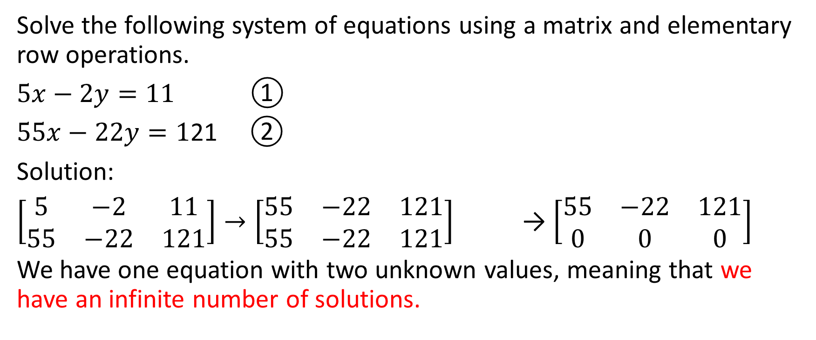
Solve the following system of equations using a matrix and elementary row operations.
$5x−2y=11$ ①
$55x−22y=1$21 ②
Solution:
$\left[\begin{matrix}5 & −2 & 11 \\ 55 & −22 & 121\end{matrix}\right]→\left[\begin{matrix}55 & −22 & 121 \\ 55 & −22 & 121\end{matrix}\right]$ → $\left[\begin{matrix}55 & −22 & 121 \\ 0 & 0 & 0\end{matrix}\right]$
We have one equation with two unknown values, meaning that we have an infinite number of solutions.

Slide 17

Example with 3 Equations
Solve the following system of equations
$3x−4y+2z+5=0$
$2x+y−7z+32=0$
$2x−3y+8z−17=0$

Slide 18
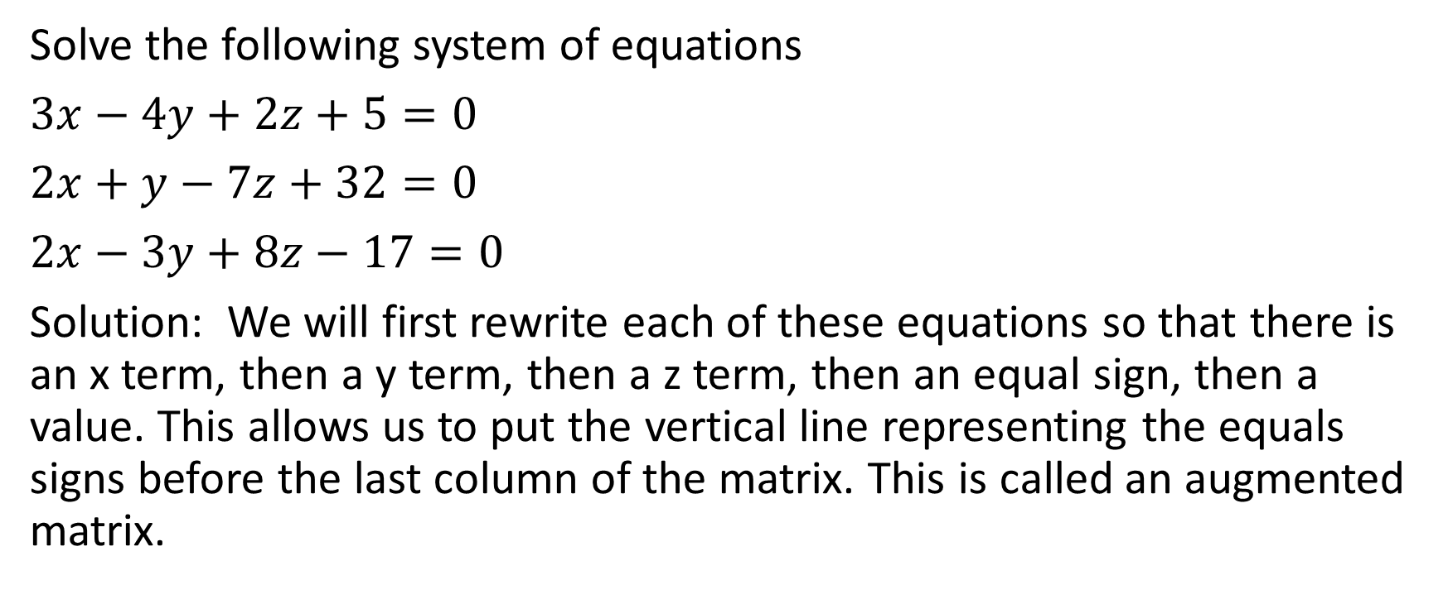
Solve the following system of equations
$3x−4y+2z+5=0$
$2x+y−7z+32=0$
$2x−3y+8z−17=0$
Solution: We will first rewrite each of these equations so that there is an x term, then a y term, then a z term, then an equal sign, then a value. This allows us to put the vertical line representing the equals signs before the last column of the matrix. This is called an augmented matrix.

Slide 19
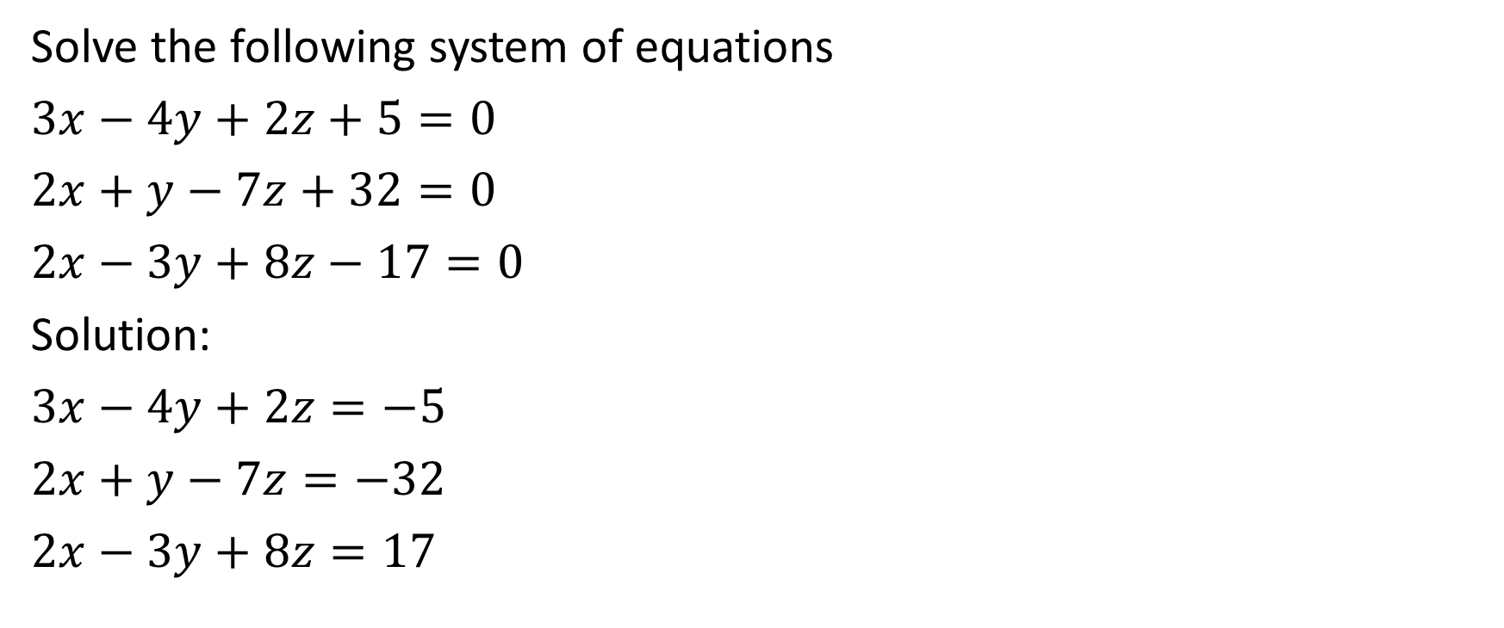
Solve the following system of equations
$3x−4y+2z+5=0$
$2x+y−7z+32=0$
$2x−3y+8z−17=0$
Solution:
$3x−4y+2z=−5$
$2x+y−7z=−32$
$2x−3y+8z=17$
Next, we will write out the matrix

Slide 20



We want to get one of the columns to have all of the same values. I usually choose to make all of the values in the x column the same first, out of habit.

Slide 21
We see that we can get all of the values in the x-column to be the same if we multiply row 1 by 2, multiply row 2 by 3 and multiply row 3 by 3. This will make each coefficient of x a 6.
We want to get one of the columns to have all of the same values. I usually choose to make all of the values in the x column the same first, out of habit.

Slide 22
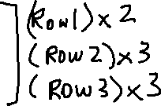

Slide 23
Next, we see that we can eliminate the coefficient of x in Row 2 and in Row 3 by subtracting Row 1 minus Row 2 and also Row 1 minus Row 3. This is one of our elementary row operations described earlier.

Slide 24

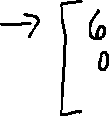

Slide 25
Now, we will try to get the values in the last two rows the same for either the y column or the z column. Out of habit, I usually choose the y column.

Slide 26

Now, we will try to get the values in the last two rows the same for either the y column or the z column. Out of habit, I usually choose the y column.
We can do this by multiplying the last row by 11 (it’s ok that the y coordinate of row 2 will be -11 and the y-coordinate of row 3 will be 11; we can eliminate by adding rather than subtracting).

Slide 27




Slide 28

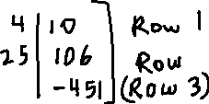



Slide 29

Now, we can add Row 2 + Row 3 to eliminate the y coefficients

Slide 30




Now, we can add Row 2 + Row 3 to eliminate the y coefficients

Slide 31

Now, we can add Row 2 + Row 3 to eliminate the y coefficients

Slide 32
Now, we can add Row 2 + Row 3 to eliminate the y coefficients
At this point, we can solve. We are trying to have one row with 2 zeros to the left of the vertical line, and we are trying to have another row with 1 zero to the left of the equals sign (and the zero that we have to the left of the equals sign in this row must be in the same column as one of the 2 zeros that we have in the other row)

Slide 33
Now, we can add Row 2 + Row 3 to eliminate the y coefficients
At this point, we can solve. We are trying to have one row with 2 zeros to the left of the vertical line, and we are trying to have another row with 1 zero to the left of the equals sign (and the zero that we have to the left of the equals sign in this row must be in the same column as one of the 2 zeros that we have in the other row)
As we will see in later examples, we often get more zeros than just the ones that we were trying to get. The number of zeros that we get has implications for the types of soutions to the system of equations (or even to the lack of a solution to the system of equations)

Slide 34
Now, we can add Row 2 + Row 3 to eliminate the y coefficients
At this point, we can solve. We are trying to have one row with 2 zeros to the left of the vertical line, and we are trying to have another row with 1 zero to the left of the equals sign (and the zero that we have to the left of the equals sign in this row must be in the same column as one of the 2 zeros that we have in the other row)
Out of habit, I usually aim to get the red triangle of zeros
As we will see in later examples, we often get more zeros than just the ones that we were trying to get. The number of zeros that we get has implications for the types of soutions to the system of equations (or even to the lack of a solution to the system of equations)

Slide 35
Now, we can add Row 2 + Row 3 to eliminate the y coefficients

Slide 36
Now, we can add Row 2 + Row 3 to eliminate the y coefficients
We can solve this system as follows:

Slide 37



Now, we can add Row 2 + Row 3 to eliminate the y coefficients
We can solve this system as follows:

Slide 38


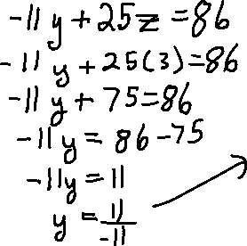

Now, we can add Row 2 + Row 3 to eliminate the y coefficients
We can solve this system as follows:

Slide 39






Now, we can add Row 2 + Row 3 to eliminate the y coefficients
We can solve this system as follows:

Slide 40
Now, we can add Row 2 + Row 3 to eliminate the y coefficients
We can solve this system as follows:
Therefore the solution to this system of equations is (-5,-1,3)

Slide 41
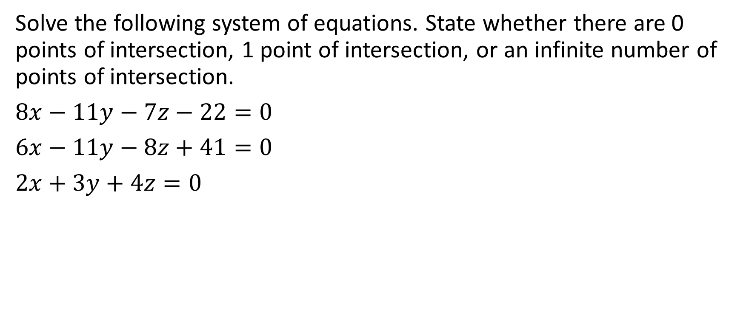
Example
Solve the following system of equations. State whether there are 0 points of intersection, 1 point of intersection, or an infinite number of points of intersection.
$8x−11y−7z−22=0$
$6x−11y−8z+41=0$
$2x+3y+4z=0$

Slide 42
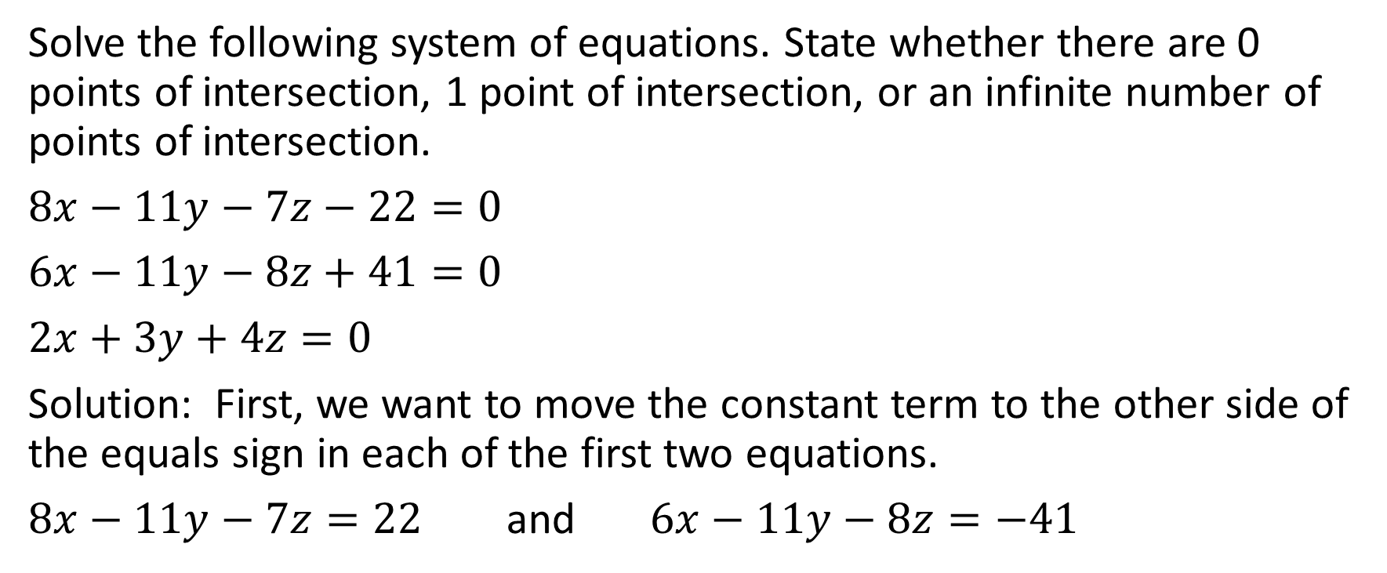
Solve the following system of equations. State whether there are 0 points of intersection, 1 point of intersection, or an infinite number of points of intersection.
$8x−11y−7z−22=0$
$6x−11y−8z+41=0$
$2x+3y+4z=0$
Solution: First, we want to move the constant term to the other side of the equals sign in each of the first two equations.
$8x−11y−7z=22$ and $6x−11y−8z=−41$

Slide 43


.

Slide 44

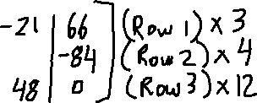
.

Slide 45
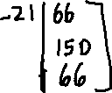



.

Slide 46



.

Slide 47




.

Slide 48

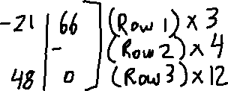
.
Look at the last row. It is impossible for 0x + 0y + 0z to equal 16596 in the real number system. Therefore there are no solutions. This is an inconsistent system

Slide 49
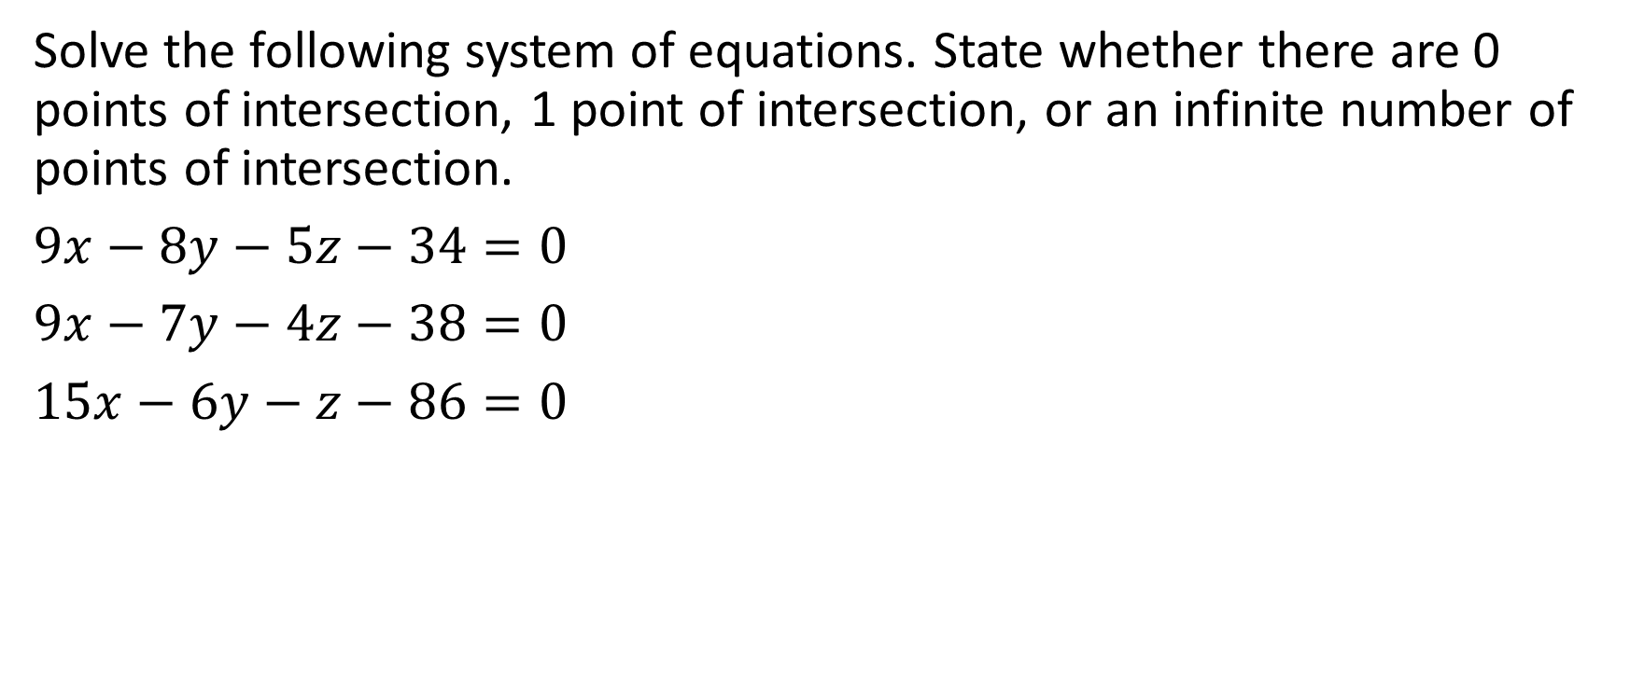
Example
Solve the following system of equations. State whether there are 0 points of intersection, 1 point of intersection, or an infinite number of points of intersection.
$9x−8y−5z−34=0$
$9x−7y−4z−38=0$
$15x−6y−z−86=0$

Slide 50
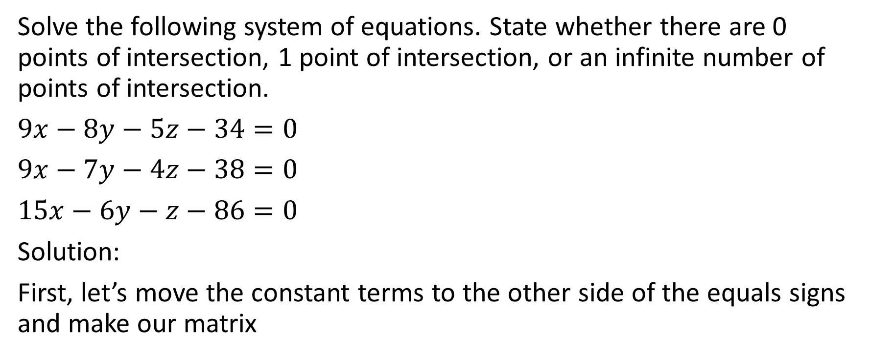
Solve the following system of equations. State whether there are 0 points of intersection, 1 point of intersection, or an infinite number of points of intersection.
$9x−8y−5z−34=0$
$9x−7y−4z−38=0$
$15x−6y−z−86=0$
Solution:
First, let’s move the constant terms to the other side of the equals signs and make our matrix

Slide 51



Slide 52




Slide 53






Slide 54
At this point, it might be reasonable to suggest multiplying Row 2 by 22 and multiplying Row 3 by 5 to get the same values in the y columns of Row 2 and Row 3 and allow us to eliminate them. That will make the numbers fairly large.

Slide 55
At this point, it might be reasonable to suggest multiplying Row 2 by 22 and multiplying Row 3 by 5 to get the same values in the y columns of Row 2 and Row 3 and allow us to eliminate them. That will make the numbers fairly large.
On the other hand, with a little bit of number sense, we might see that every entry in the second row is divisible by 5 and every entry in the third row is divisible by 22. Therefore, if we multiply row 2 by 1/5 and multiply row 3 by 1/22, we will get the same value in the y-column of both rows, making the numbers a little easier to work with.

Slide 56
At this point, it might be reasonable to suggest multiplying Row 2 by 22 and multiplying Row 3 by 5 to get the same values in the y columns of Row 2 and Row 3 and allow us to eliminate them. That will make the numbers fairly large.
On the other hand, with a little bit of number sense, we might see that every entry in the second row is divisible by 5 and every entry in the third row is divisible by 22. Therefore, if we multiply row 2 by 1/5 and multiply row 3 by 1/22, we will get the same value in the y-column of both rows, making the numbers a little easier to work with.
Either approach is acceptable.

Slide 57




Slide 58

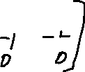

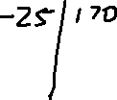

Slide 59
The last row is 0x + 0y + 0z = 0. There are an infinite number of points that satisfy that condition. Therefore there are an infinite number of solutions to this system of equations.

Slide 60
The last row is 0x + 0y + 0z = 0. There are an infinite number of points that satisfy that condition. Therefore there are an infinite number of solutions to this system of equations.
*** Technically, we need to double check that the top two rows don’t represent parallel planes that never touch. However, since the normal vectors of those two planes, specifically (45, -40, -25) and (0, -1, -1), are not collinear, therefore this is not a concern. Therefore this is a consistent system with an infinite number of solutions.

Slide 61

Example
Consider the following system of equations
$kx−4y=10$
$−2x+8y=−20$
Solve for $k$ such that this system has 0 solutions, 1 solution, or an infinite number of solutions

Slide 62





Consider the following system of equations
$kx−4y=10$
$−2x+8y=−20$
Solve for $k$ such that this system has 0 solutions, 1 solution, or an infinite number of solutions
Solution

Slide 63














Consider the following system of equations
$kx−4y=10$
$−2x+8y=−20$
Solve for $k$ such that this system has 0 solutions, 1 solution, or an infinite number of solutions
Solution

Slide 64


















Consider the following system of equations
$kx−4y=10$
$−2x+8y=−20$
Solve for $k$ such that this system has 0 solutions, 1 solution, or an infinite number of solutions
Solution

Slide 65








Consider the following system of equations
$kx−4y=10$
$−2x+8y=−20$
Solve for $k$ such that this system has 0 solutions, 1 solution, or an infinite number of solutions
Solution
If there are an infinite number of solutions, then the final row will be all zeroes. This means that 2k – 2 = 0.
Which means that k = 1.

Slide 66
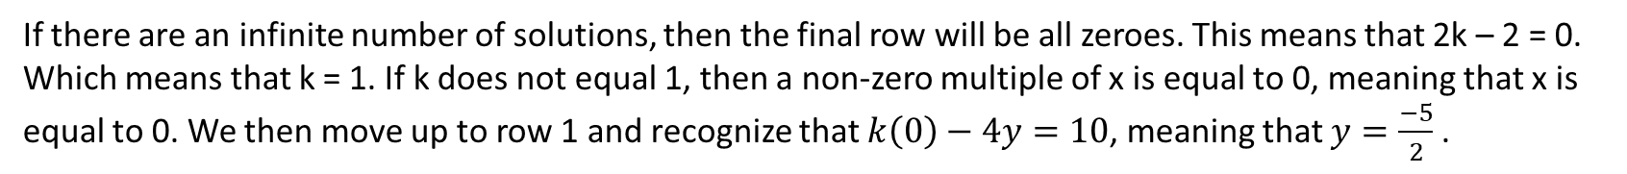
Consider the following system of equations
$kx−4y=10$
$−2x+8y=−20$
Solve for $k$ such that this system has 0 solutions, 1 solution, or an infinite number of solutions
Solution
If there are an infinite number of solutions, then the final row will be all zeroes. This means that 2k – 2 = 0.
Which means that k = 1. If k does not equal 1, then a non-zero multiple of x is equal to 0, meaning that x is equal to 0. We then move up to row 1 and recognize that $k\left(0\right)−4y=10$, meaning that $y=\frac{−5}{2}$ .

Slide 67

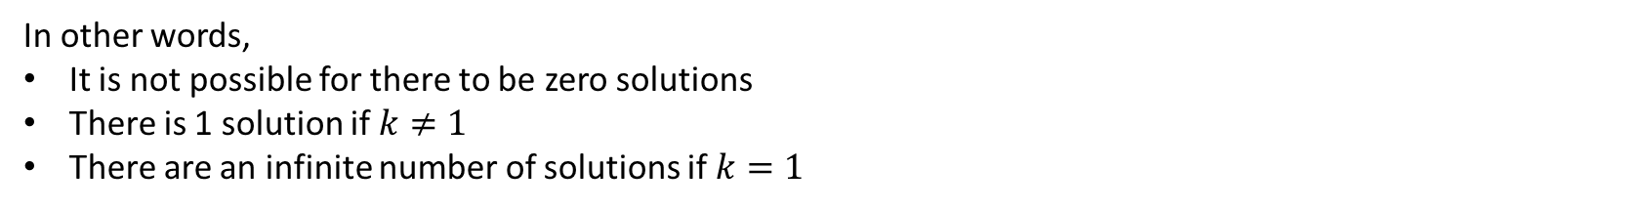
Consider the following system of equations
$kx−4y=10$
$−2x+8y=−20$
Solve for $k$ such that this system has 0 solutions, 1 solution, or an infinite number of solutions
Solution
I
In other words,
It is not possible for there to be zero solutions
There is 1 solution if $k≠1$
There are an infinite number of solutions if $k=1$

